Slide 1
FY26 Proposed Budget (5/20/2025) Red Bank Tennessee
City Manager Martin Granum
Chief Financial Officer Kris Pickel
20 May 2025

Slide 2
Agenda
FY26 Budget Packet (and where to find all the info)
Budget Dates for FY26
Reappraisal Year!
Budget adoption process
Mission, Vision, Goals
Changes in this Proposed Budget from earlier versions of the Budget Estimate
Significant Budget Features for FY26
An eye on future budgets…
Wrap up

Slide 3
Review of FY26 Budget Packet (available online)
On the City of Red Bank’s webpage at…
Departments…
Administration and Finance…
Finance…
FY26 Budget Development…
16 separate items for quality, useful budget information
Or you can hit the Budget button on the home page! ☺
Here are the major components of the Budget Packet:
Guide to the Red Bank FY26 Budget (4 pages)
Budget Spreadsheet for all funds (32 pages)
City Manager’s FY26 Budget Memo and each Department’s memo (7 documents; 21 pages in total… hear directly from each Director/Chief/Clerk)
Q & A (18 pages total)
Two Special Exhibits: Jobs by Grade (the pay for every city employee), and the items being funded by debt (all in Public Works)
And more…

Slide 4
Budget Dates for FY26 (revised memo 15 April 2025)
Tuesday, 15 April: During the normal Work Session at 4:30 (early start) “Budget 101” presentation by staff on the budget process including a review of this year’s FY25 budget
Tuesday, 22 April: Budget Workshop #1 of 2, 5:00 – 7:30 City Manager to provide the Commission the FY26 Budget Estimate to include brief overview of any substantial changes from FY25. Police presentation from Chief Seymour; Fire presentation from Chief Sylar, Court presentation from Court Clerk Donahue; Citizen Comments at the end
Tuesday, 29 April: Budget Workshop #2 of 2; 5:00 – 7:30 Public Works presentation from Director Tate; Community Development presentation from Director Johnson; City Hall (Administration & Finance) presentation from Director Perry; Citizen Comments at the end
Tuesday, 6 May: During the normal Work Session at 4:30 (early start) Open discussion by the Commission of the budget estimate
Tuesday, 20 May at regular Commission Work Session/Meeting… budget ordinance first reading of the Proposed Budget
Tuesday, 3 June at regular Commission Work Session/Meeting… budget ordinance second reading of the Proposed Budget. Upon adoption, becomes the FY26 Adopted Budget

Slide 5
Reappraisal Year!
Typically a key component of each year’s Budget Ordinance is the Commission establishing the tax rate for that year
However, this is a ‘reappraisal year’… in Hamilton County it’s every fourth year
In accordance with TN Statute, the Hamilton County Assessor of Property is finalizing the reappraisal process by completing about 500 appeals, then he will prepare a submission to the Comptroller
At this interim point in the process the median appraisal change for all residential and commercial properties in Red Bank… 5,253 parcels in all… is 59.05% increase
The Comptroller then completes the process by incorporating data from the Office of State Assessed Properties (OSAP) and administering the State Board of Equalization. Then the Comptroller can notify us of our revenue neutral certified tax rate (often called the CTR)
We anticipate notification of Red Bank’s CTR sometime in the coming months. In the meantime, we must await notification of the CTR before the Commission can formally adopt a new tax rate
For the purposes of submitting the budget to the Comptroller, their guidance is to remain silent on the tax rate itself, but we are required to state our intentions regarding either increasing property tax revenue (i.e. a tax increase), or not increasing property tax revenue (i.e. remain revenue neutral)

Slide 6
The FY26 Budget Adoption Process
Receipt of the TN Comptroller’s memo each year formally starts the budget process (10 Feb 2025)
Staff attend the Chattanooga Area Chamber of Commerce annual Economic Outlook Breakfast, featuring insights from Dr. David Altig, Executive VP at the Federal Reserve Bank of Atlanta, and Dr. Howard Wall, Chief Economist at UTC (18 Feb 2025)
Budget preparation began in earnest in conversations with department directors beginning in March
Budget Dates for FY26 published on 15 April 2025
Two Budget Workshops (22, 29 April)
Citizens who earn the Budget Academy Certificate will be recognized at 1st Reading
City Charter requires City Manger to present ‘Budget Estimate’ to the Commission NLT 15 May each year (occurred 22 Apr 2025)
The budget process also sets the property tax rate; however, i.a.w. TN Statute, this being a ‘reappraisal year’ with the timing independent of the budget process, a separate ordinance will be necessary to establish the property tax rate once the certified tax rate (CTR) is received… typically mid- to late Summer
In Red Bank, any Ordinance requires two readings
The 1st Reading of the Budget Ordinance is tonight (20 May)
The 2nd Reading of the Budget Ordinance is scheduled for 3 June
Enactment occurs upon passing at 2nd Reading; it becomes the Adopted Budget and takes effect 1 July 2025 and continues through 30 June 2026
The CFO must file the budget, in a very specific format, with the Comptroller within 15 days of adoption
As mentioned above, during a reappraisal year the Commission will adopt a property tax rate separately after receipt of the CTR; this historically has taken place in August/September of a reappraisal year

Slide 7
Mission Vision Goals
Always good to remind ourselves, and especially in budget season…

Slide 8
Mission… from the 4th Annual Commission Strategic Planning Retreat (25 Feb 2025); Res. No. 25-1778
Mission (the purpose of a city’s being and why it exists): The City of Red Bank is a safe and thriving small-town community with an engaging, transparent government that builds on our rich history, provides excellent and efficient services, and welcomes all

Slide 9
Vision… from the 4th Annual Commission Strategic Planning Retreat (25 Feb 2025); Res. No. 25-1778
Vision (builds upon the mission and takes it to the next level; a desired future state): Red Bank strives for a vibrant, growing and inclusive community by pursuing excellence, enhancing safety, celebrating our neighborhood character and stewarding our natural landscapes

Slide 10
Goals… from the 4th Annual Commission Strategic Planning Retreat (25 Feb 2025); Res. No. 25-1778)
Goals (after an environmental analysis and applying the SWOT methodology, issues were identified and ultimately goals were set that: address the key issues, meet the mission of the City and help the City to achieve its vision):
Develop a new land conversion agreement with TDEC and NPS (Mayor Dalton)
Create priorities for safe streets: curtailing speeding, enhancing pedestrian walkability, and protected cycling routes (Commissioner Fairbanks-Harvey)
Launch strategic economic development efforts to attract investment, support local businesses, and strengthen community prosperity (Commissioner Holmes)
Implementation of the Parks Master Plan (Commissioner Wilkinson)
Low-cost activation of city property by making improvements (i.e. tables, gardens, etc.) (Vice Mayor Berry)

Slide 11
Changes reflected in the FY26 Proposed Budget from earlier budget estimates dated (4/22/2025)
Current Budget Estimate is dated 5/20/2025
Personnel expenses increased to reflect a COLA of 2.0 percent
Under the direction of the Department of Administration & Finance (Tracey & Kris) the Departments absorbed the change in their budgets
‘Total Expenditure’ did not grow (it slightly decreased from 4/22)
Increased Property Tax revenue by 5%
See budget page 2 and specifically, the line for ACCT # 31100
Increased from $5,250,000 to $5,512,500
This will require a 5% property tax increase when the tax rate is established later this year

Slide 12
Significant Features of the FY26 Budget
Staffing
Services
Borrowing
Excellence

Slide 13
Significant Budget Features for FY26: Staffing
Make modest and targeted staff investments in four specific instances to build staff capacity where it is most needed; specifically:
As planned, with the expiration of the violent crime incentive fund grant (‘VCIF grant’) in the current year (FY25), the proposed budget funds and makes permanent this detective position, our 26th sworn officer, at a cost of approximately $75,000;
Reclassify two existing administrative staff to the appropriate classification:
Office Manager in Community Development at a cost of $2,246, and
Executive Office Manager in the Police Department at a cost of $5,301; and
Converts the part-time Parks & Recreation Program Assistant position to full time at a cost of approximately $18,500;
All staff pay is in the budget packet and on the webpage ‘FY26 Proposed Jobs by Grade’

Slide 14
Significant Budget Features for FY26: Services
TAX RELIEF: 100% match to the county’s portion of tax relief for approximately 138 Red Bank residents currently in the tax relief program
$11,290.80 for qualified taxpayers over 65 (approximately 116)
$14,427.84 for all 100% disabled Veterans (approximately 22)
Altogether the total budget estimate for Red Bank’s tax relief match is approximately $25,718.64 (not an ‘expense’ but foregone revenue)
This Tax Relief program is strongly endorsed by the Hamilton County Trustee and is universally viewed as a very effective means to help qualified Red Bank residents stay in their home who would otherwise struggle to make property tax payments and are at risk of losing their home
CARE-A-VAN: sustains CARTA paratransit services in FY26 by budgeting $30,000 to reflect the actual ‘post-5310 grant’ per-trip subsidy required of the City. Budgeted amounts are up $14,400 from last year’s budgeted amount of $15,600 which was a capped exposure mutually agreed upon with CARTA. You may recall paratransit in Red Bank serves qualified residents who are most often using the service for medical appointments which is frequently dialysis
DATA DRIVEN: budgets $15,000 for On-call Data Analyst Services. The city will develop a data strategy to enhance our data maturity by recognizing and utilizing available metadata to provide insights and make informed decisions. Identify data sources, provide analyses and discern take-aways such as needs and trends, and ultimately create data visualization to promote understanding and informed decision making. Initial uses will be for analysis of property tax rates, help build a capital improvement plan, accurately project revenue growth as the city develops, and more use cases

Slide 15
Significant Budget Features for FY26: Borrowing
Included in the budget estimate is the use of debt by the Public Works department for the following three applications allocated across the appropriate three funds:
$230,000 General Fund loan for a pickup and tractor in Streets Division,
$110,000 for two pickups in Solid Waste Division, and
$900,000 for a dump truck with salt spreader and snowplow attachments as well as a significant road paving effort on our secondary roads in State Street Aid.

Slide 16
Significant Budget Features for FY26: Excellence
COLA of 2.0 percent to keep pace with inflation, continue to attract and retain top talent, and maintain our competitive position in the market as an Employer of Choice
Costs/Expenses are well managed (example: Insurance p. 6) which are down slightly from FY24
Addresses all five Commission Goals which, for the fourth consecutive year, largely fall to two departments: the Public Works Department and the Community Development Department
Specifics regarding our plans to achieve those five goals are detailed in the Public Works’ and the Community Development’s department budget memos
Sustains a level of service delivery excellence across all municipal services delivered through all six departments: Police, Fire, Court, Administration & Finance, Public Works, and Community Development

Slide 17
An eye on future budgets….
Always…
Provide quality, timely, useful budget information to the Community throughout the budget process
Focus on the Commission Goals from the annual retreat (each February)
Remain an Employer of Choice year over year
For future budgets…
Capital Improvement Plan (facilities; parks/trails/pool; streets/multimodal functionality; FRBMSS SAS; and more)
Additional staffing in Public Works (stormwater supervisor is top of the list)
Additional staffing in Fire Department (3 FTE) to provide a fifth full-time firefighter on each shift (tentatively linked to COE on the planned 210-unit high-rise apartment complex)
Expanding the tax base by encouraging density and development (such as expanding the public sewer and updating our zoning and land use policies)

Slide 18

City of Red Bank
Organizational Overview
27 March 2025
Community Development
Leslie Johnson
Director
Eddie Clinton
Building Official
Summer Sheldon
Asst City Recorder/
Outreach
Kris Pickel
CFO
Fire Chief Brent Sylar
(Building Inspector)
Michael Pham
Planner
Ruthie Rohen
Clerk (PT)
Greg Tate Director
Beth Powell Office Manager
Tracey Perry
Director of Admin & Finance/
City Recorder/
HR
City
Hall
Fire Department
Kate Hackney
Executive Office Manager
Ricky Reeves
Operations Supervisor
Andrew Wood Fire Training Captain
Jerry Carter
Assistant Chief (Vol)
Deputy Chief/Fire Marshal
Eddie Iles
Stacey Bradley-
Rump
IT Manager
Court
April Sledge
Assistant CFO/
Payroll
JB Allen Solid Waste Supervisor
(8)
Alicia Donahue
Court Clerk
Judge Johnny Houston
Nate Hall
Engineering Tech
Streets & Roads
(8)
4 Shifts
Captain Darren Brandon +3
Captain Corey Johnson +3
Captain Larry Olivier +3
Captain Scott Pell (PT)
Police Department
Justin Headrick
Facilities Manager
Storm Water
(3)
Alley Hindmon
Deputy Clerk
Public Works Department
Valarie Cowell
Office Manager
Detective Sgt. Steve Hope +3
Jeffrey Grabe
Parks & Recreation Manager
Martin Granum
City Manager
Randy Bell Fleet Services Manager (1)
Festival: Jubilee, Christmas
Planning
Kristen
Hill
Record Coordi-nator
4 Shifts (16)
Sgt Erlinger +3
Sgt Keown +3
SSgt Noorbergen +4
Sgt Waters +4
Det. Dennis
K-9 Officer
BZA
Key Partners
Arnold Stulce, City Attorney Bridgett Raper & Small Cities Coalition
James Exum, Admin. Hearing Officer Honna Rogers & MTAS
McKamey Animal Center CARTA Care-A-Van
First Horizon Cumberland Securities
The Baldwin Group; Atlas Insurance Agency RJ Young
Pool Advisory Committee (PAC)/Boxing/RBYA Trust for Public Land (TPL)
Mutual Aid Partners (HCSO, CFD, others) TPO/MPO/TCC (RPA); SETDD
Hamilton County Service Partners: Elections; WWTA; other utility providers
911; GIS; Recycling; Water Quality; Trustee RBSD Charitable Foundation
City Commission
Cemetery
Deputy Chief John Wright
Sgt. Rusty Aalberg
Professional Services
Art
Chief of Police/CIO Dan Seymour
Parks, Trails & Rec
Nonprofit
Commissions

Slide 19
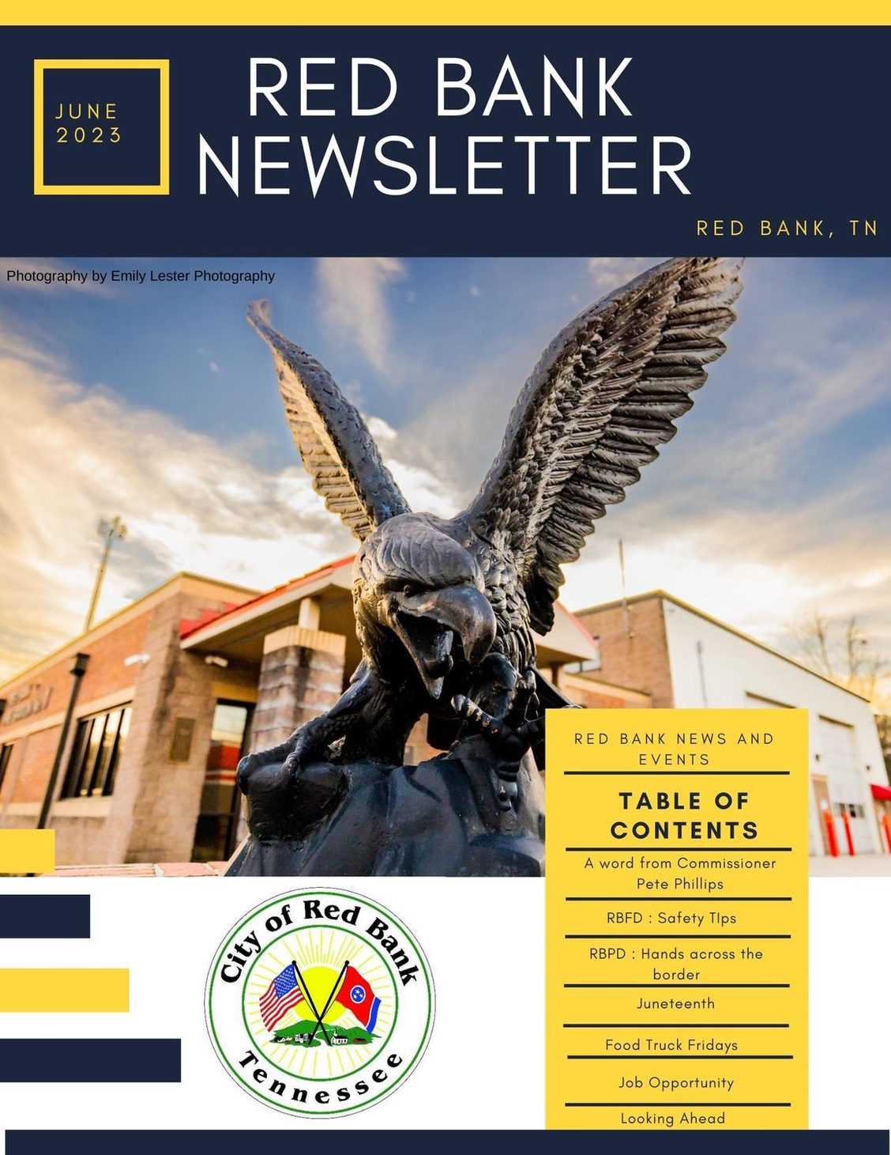
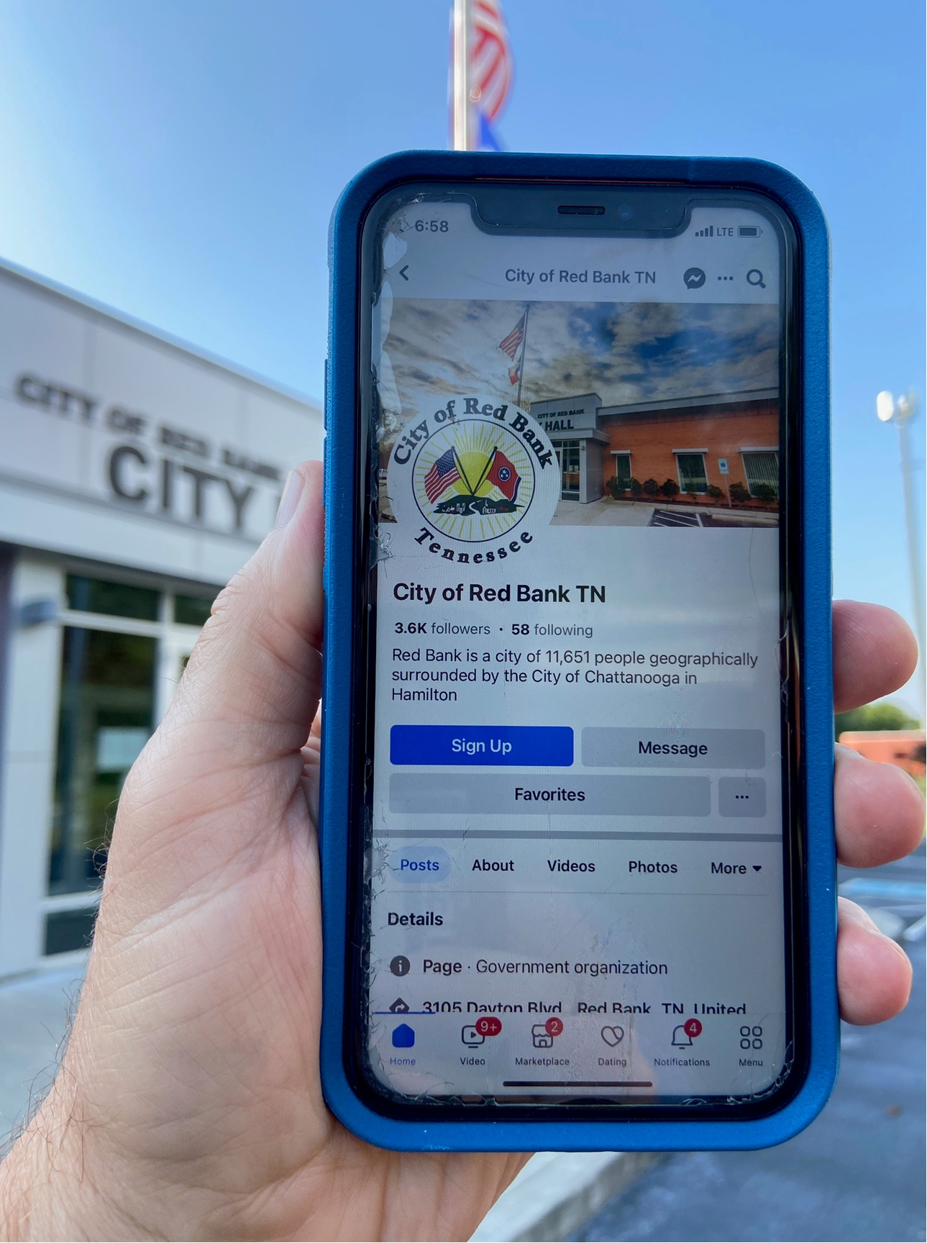
Wrap up… stay informed
Facebook City of Red Bank TN
Instagram City of Red Bank
Webpage www.redbanktn.gov
Subscribe to our monthly newsletter at www.redbanktn.gov
Attend a Commission meeting 1st and 3rd Tuesday (except 1st Tues in January and July)
Thank you!

Slide 20
FY26 Proposed Budget (5/20/2025) Red Bank Tennessee
City Manager Martin Granum
Chief Financial Officer Kris Pickel
20 May 2025

Slide 21
City of Red Bank Tennessee How to calculate your residential property tax

Slide 22
How to calculate your residential property taxes in Red Bank TN (values are from previous assessment)
Find your Assessed Value
Hamilton County GIS https://gismaps.hamiltontn.gov/Html5Viewer/index.html?viewer=GISMO5.GIS_HTML51
Or you can also go to the Hamilton County Trustee website https://tpti.hamiltontn.gov/
Divide the figure by 100
Multiply by the property tax rate
The tax rate for FY25 was $1.67 for Red Bank
Example for a house on Hunter Trail
Total Value: $236,100
Assessed value: $59,025
Divide by 100 = $590.25
Multiply by the Levy (currently $1.67) $985.72
With a levy of $1.67 the property taxes are $985.72

Slide 23
Property Assessments: Information by County
Visit the Comptroller’s excellent website for more info…
https://comptroller.tn.gov/office-functions/pa/tax-resources/assessment-information-for-each-county/information-by-county.html

