Slide 1
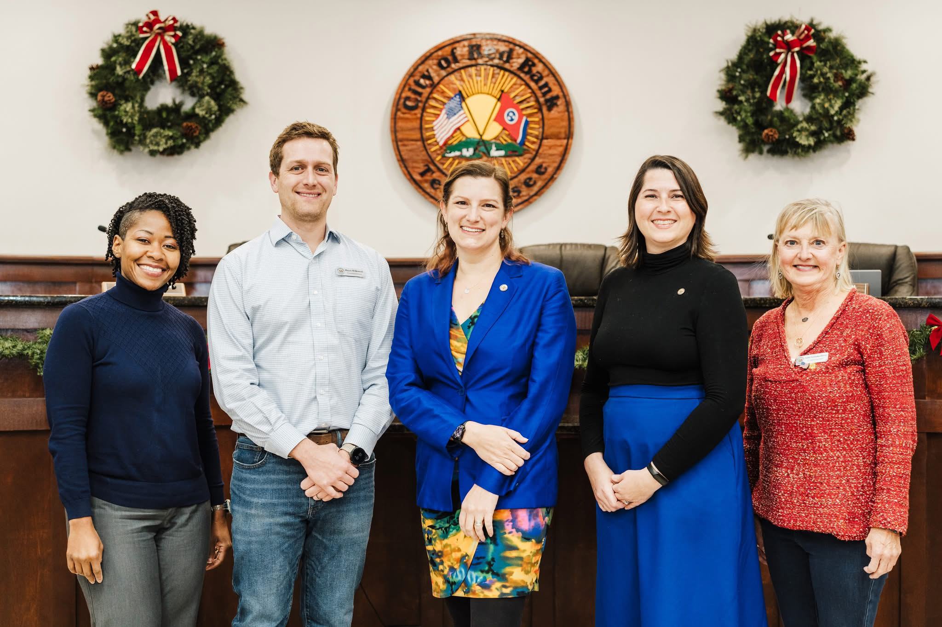
City of Red Bank Commission
All Commissioners elected city-wide (at-large); Mayor and Vice Mayor selected by Commission
Mayor Stefanie Dalton
Vice Mayor Hollie Berry
Commissioner Jamie Fairbanks-Harvey
Commissioner Terri Holmes
Commissioner Hayes Wilkinson
Notes:
Nonprofit Citizens Advisor Committee likely next. Likely Parks & Rec. Possibly joining Art with Beautification post-retreat.

Slide 2
Mission… from the 4th Annual Commission Strategic Planning Retreat (25 Feb 2025); Res. No. 25-1778
Mission (the purpose of a city’s being and why it exists): The City of Red Bank is a safe and thriving small-town community with an engaging, transparent government that builds on our rich history, provides excellent and efficient services, and welcomes all

Slide 3
Vision… from the 4th Annual Commission Strategic Planning Retreat (25 Feb ’25); Res. No. 25-1778
Vision (builds upon the mission and takes it to the next level; a desired future state): Red Bank strives for a vibrant, growing and inclusive community by pursuing excellence, enhancing safety, celebrating our neighborhood character and stewarding our natural landscapes

Slide 4
Goals… from the 4th Annual Commission Strategic Planning Retreat (25 Feb ’25); Res. No. 25-1778)
Goals (after an environmental analysis and applying the SWOT methodology, issues were identified and ultimately goals were set that: address the key issues, meet the mission of the City and help the City to achieve its vision):
Develop a new land conversion agreement with TDEC and NPS (Mayor Dalton)
Create priorities for safe streets: curtailing speeding, enhancing pedestrian walkability, and protected cycling routes (Commissioner Fairbanks-Harvey)
Launch strategic economic development efforts to attract investment, support local businesses, and strengthen community prosperity. (Commissioner Holmes)
Implementation of the Parks Master Plan (Commissioner Wilkinson)
Low-cost activation of city property by making improvements (i.e. tables, gardens, etc.) (Vice Mayor Berry)

Slide 5

City of Red Bank
Organizational Overview
27 March 2025
Community Development
Leslie Johnson
Director
Eddie Clinton
Building Official
Summer Sheldon
Asst City Recorder/
Outreach
Kris Pickel
CFO
Fire Chief Brent Sylar
(Building Inspector)
Michael Pham
Planner
Ruthie Rohen
Clerk (PT)
Greg Tate Director
Beth Powell Office Manager
Tracey Perry
Director of Admin & Finance/
City Recorder/
HR
City
Hall
Fire Department
Kate Hackney
Executive Office Manager
Ricky Reeves
Operations Supervisor
Andrew Wood Fire Training Captain
Jerry Carter
Assistant Chief (Vol)
Deputy Chief/Fire Marshal
Eddie Iles
Stacey Bradley-
Rump
IT Manager
Court
April Sledge
Assistant CFO/
Payroll
JB Allen Solid Waste Supervisor
(8)
Alicia Donahue
Court Clerk
Judge Johnny Houston
Nate Hall
Engineering Tech
Streets & Roads
(8)
4 Shifts
Captain Darren Brandon +3
Captain Corey Johnson +3
Captain Larry Olivier +3
Captain Scott Pell (PT)
Police Department
Justin Headrick
Facilities Manager
Storm Water
(3)
Alley Hindmon
Deputy Clerk
Public Works Department
Valarie Cowell
Office Manager
Detective Sgt. Steve Hope +3
Jeffrey Grabe
Parks & Recreation Manager
Martin Granum
City Manager
Randy Bell Fleet Services Manager (1)
Festival: Jubilee, Christmas
Planning
Kristen
Hill
Record Coordi-nator
4 Shifts (16)
Sgt Erlinger +3
Sgt Keown +3
SSgt Noorbergen +4
Sgt Waters +4
Det. Dennis
K-9 Officer
BZA
Key Partners
Arnold Stulce, City Attorney Bridgett Raper & Small Cities Coalition
James Exum, Admin. Hearing Officer Honna Rogers & MTAS
McKamey Animal Center CARTA Care-A-Van
First Horizon Cumberland Securities
The Baldwin Group; Atlas Insurance Agency RJ Young
Pool Advisory Committee (PAC)/Boxing/RBYA Trust for Public Land (TPL)
Mutual Aid Partners (HCSO, CFD, others) TPO/MPO/TCC (RPA); SETDD
Hamilton County Service Partners: Elections; WWTA; other utility providers
911; GIS; Recycling; Water Quality; Trustee RBSD Charitable Foundation
City Commission
Cemetery
Deputy Chief John Wright
Sgt. Rusty Aalberg
Professional Services
Art
Chief of Police/CIO Dan Seymour
Parks, Trails & Rec
Nonprofit
Commissions

Slide 6
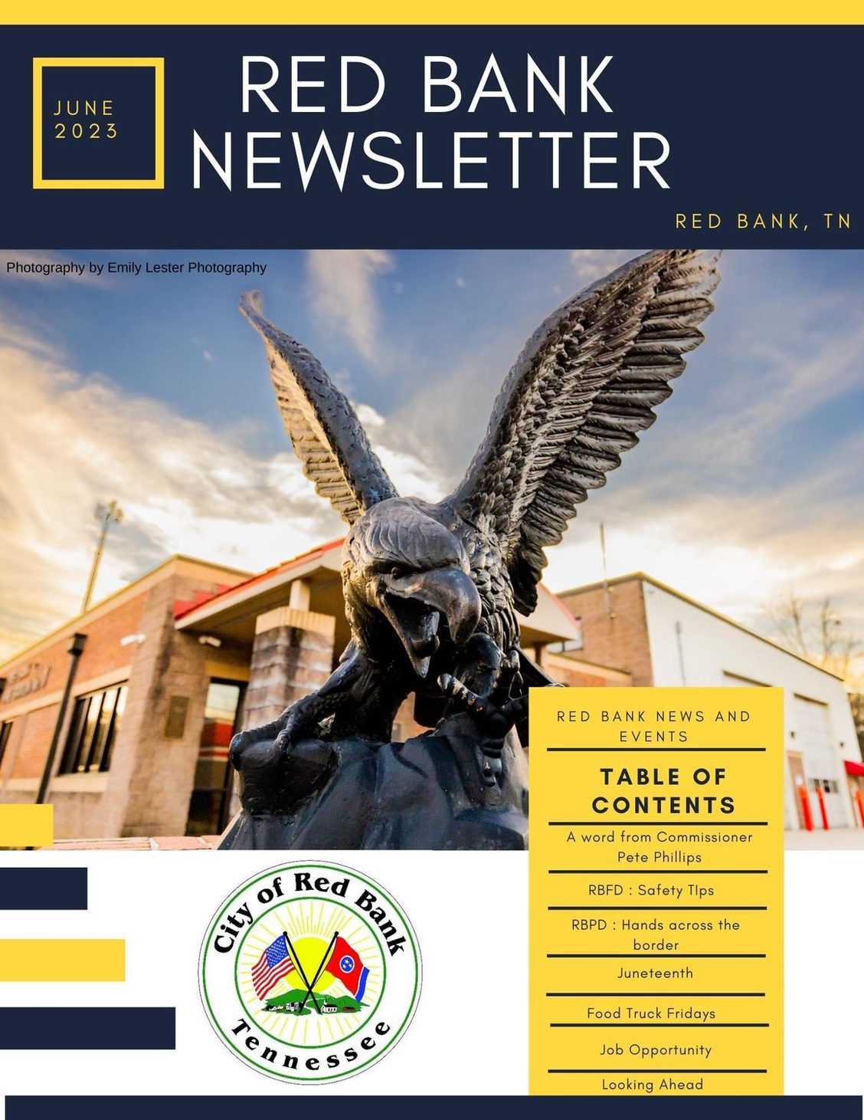
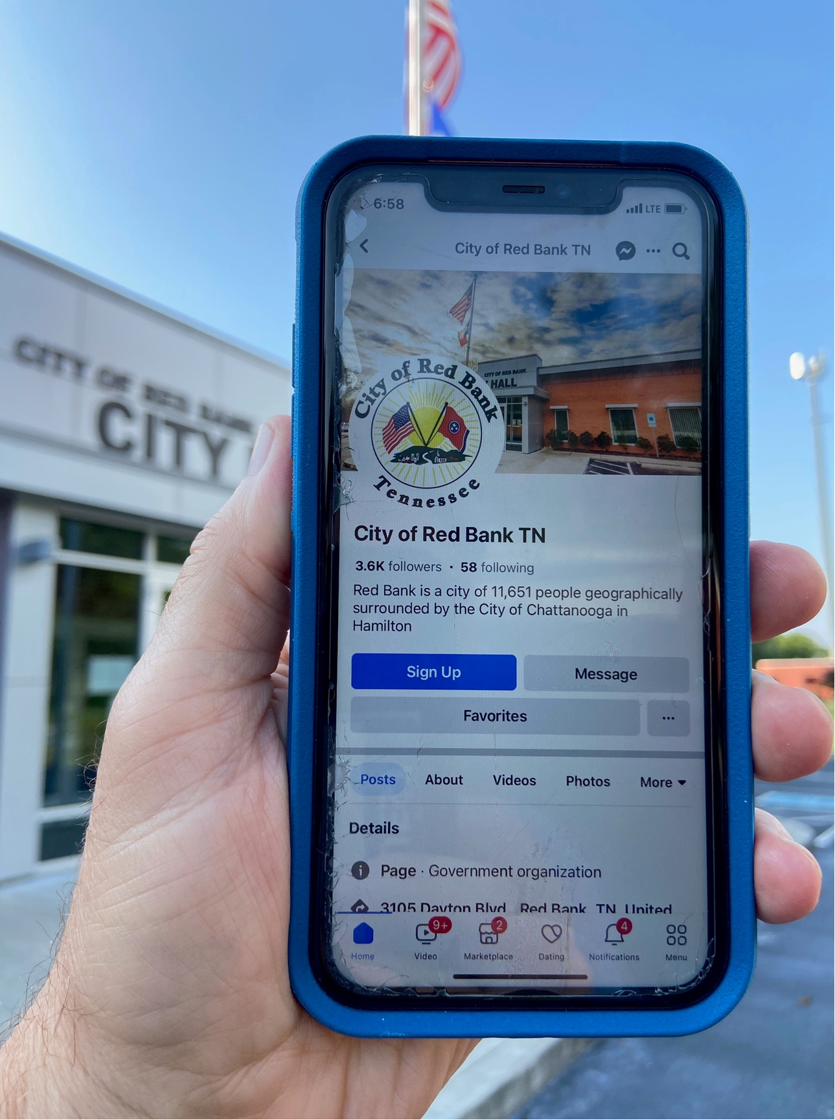
Stay Informed…
Facebook City of Red Bank TN
Instagram City of Red Bank
Webpage www.redbanktn.gov
Subscribe to our monthly newsletter at www.redbanktn.gov
Attend a Commission meeting 1st and 3rd Tuesday (except 1st Tues in January and July)
Thank you!

